Slide 1



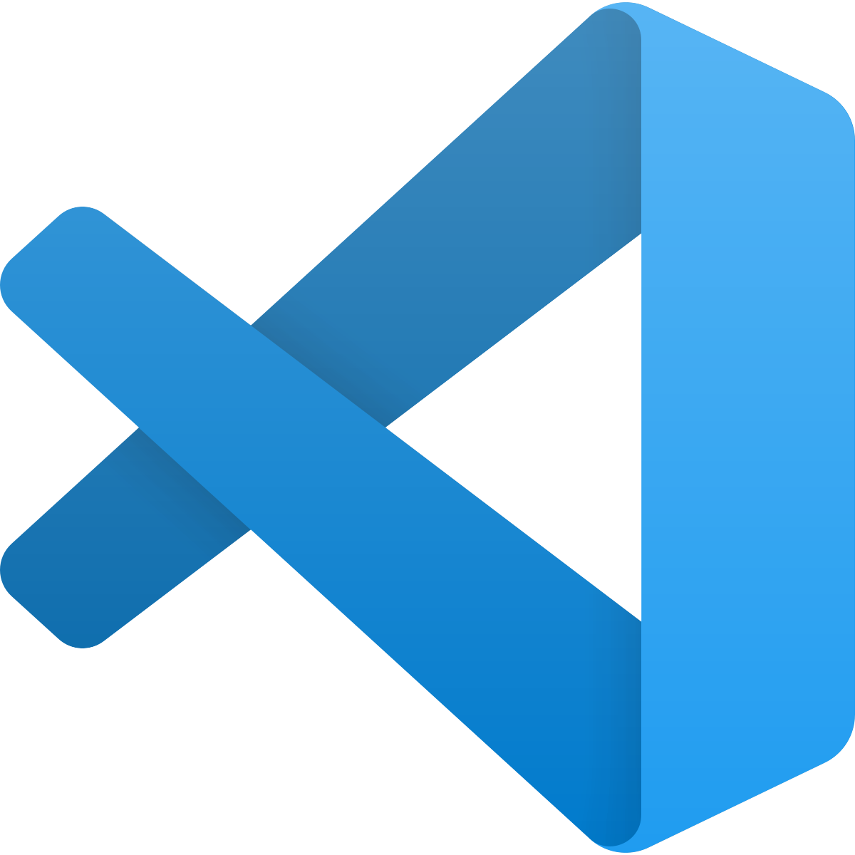
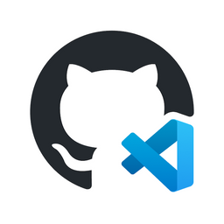

CDE - Cloud Development Environment Gitpod GitHub Codespaces
Linux VM
Linux VM
Conclusion Code Café – 17 november 2022
Lucas Jellema, CTO & Architect AMIS | Conclusion

Slide 2
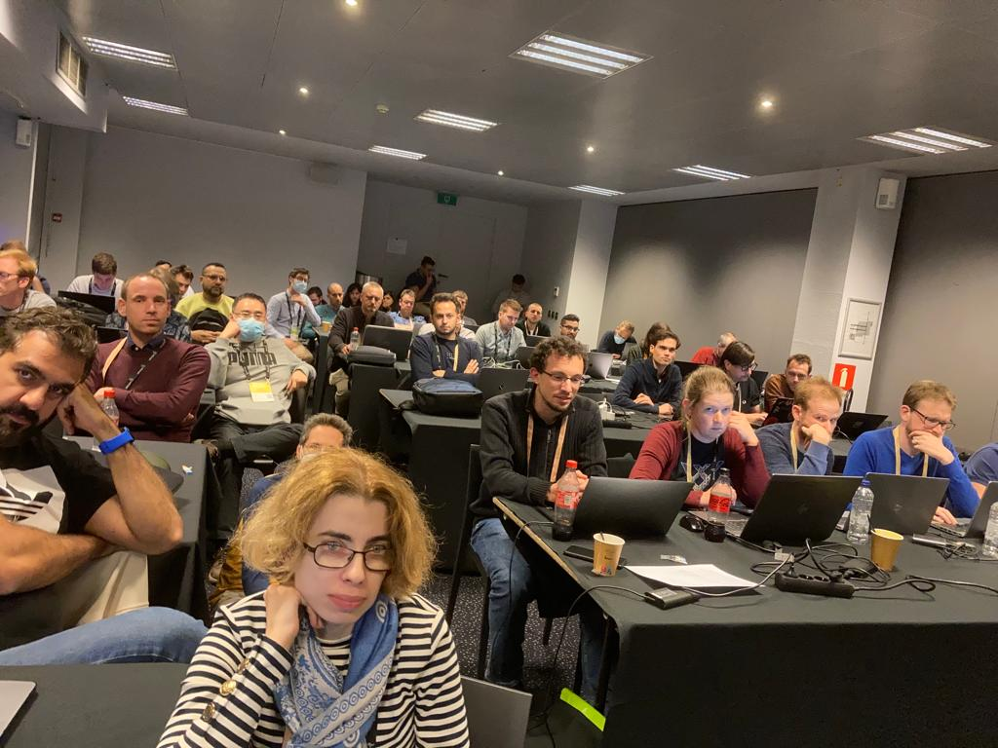
Handson Workshop at Conference
Download workshop resources to your laptop
over the conference WiFi
with 100s of other attendees
Or …
download
Linux VM

Slide 3
Gitpod – Cloud & Browser Based Development Environment
VM with VS Code & 10 language runtimes + 20 tools
including Docker
8-12 GB RAM, 6 vCores, 30 GB Storage
Predefined Setup & Startup – based on Git repo
download files, start services, run containers, open files
Free plan: 50 hours / month (next 50 hours: $8/month)
with GitHub or GitLab account
Open Source platform - self-hosted is an option
Linux VM

Slide 4
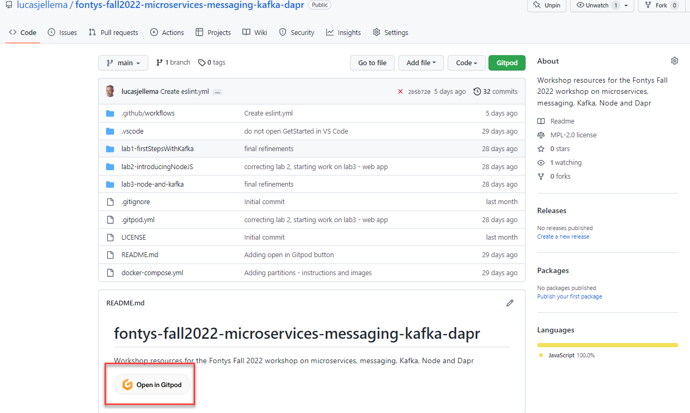
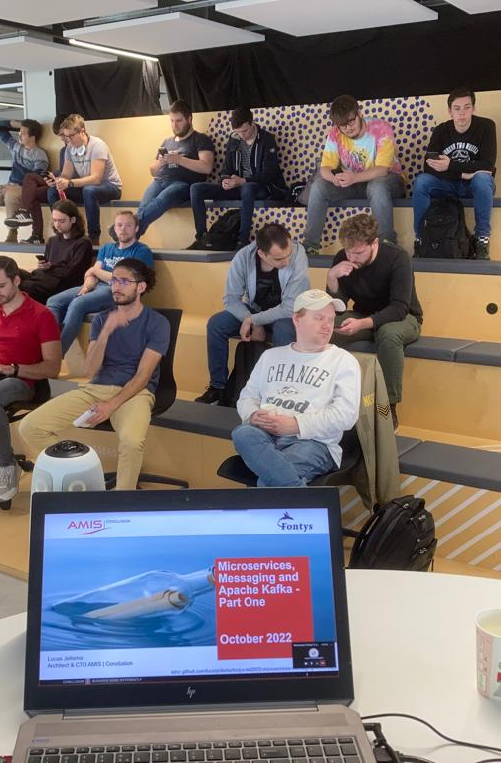
Workshop with 50+ students at Fontys

Slide 5
Gitpod – Cloud & Browser Based Development Environment
A Gitpod Workspace is created from a Git repository
for specific branch, tag, PR
simple URL is all it takes: https://gitpod.io/#<git repo url>
Automatically contains sources from repository
Great for: trying things out, reviewing a PR, contributing to OSS, providing a workshop environment, working on any device & anywhere
Share Workspace – collaborate live in same environment
Create and Share Snapshot – customized workspace ready to run
Expose public ports – access services and web applications in workspace from anywhere
Integration with local IDE (VS Code, JetBrains)
Potential benefits: cost saving, green?, efficient, sparking learning & innovation
Linux VM

Slide 6
Base Image Gitpod
Linux VM
Ubuntu 20.4
VS Code (browser based)
git, Docker, Docker Compose, Maven, Gradle, npm, jq, Nix, Homebrew, Tailscale, Nginx
Go, Java, Node.js, C/C++, .Net, Python, Ruby, Rust & PHP, Clojure
Language specific base images
Full VNC image – for desktop applications (using X11 Display Server)
Fine tune at workspace startup time with
installation/configuration actions in .gitpod.yaml file (similar to devcontainer.json)
custom Docker-file
Use custom container image

Slide 7
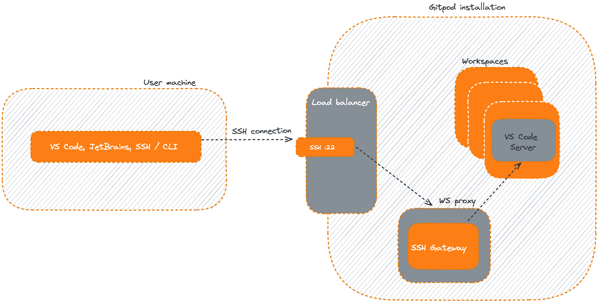
Work from your local VS Code or JetBrains IDE
IDE extensions for Gitpod – to work locally against remote Gitpod workspace

Slide 8
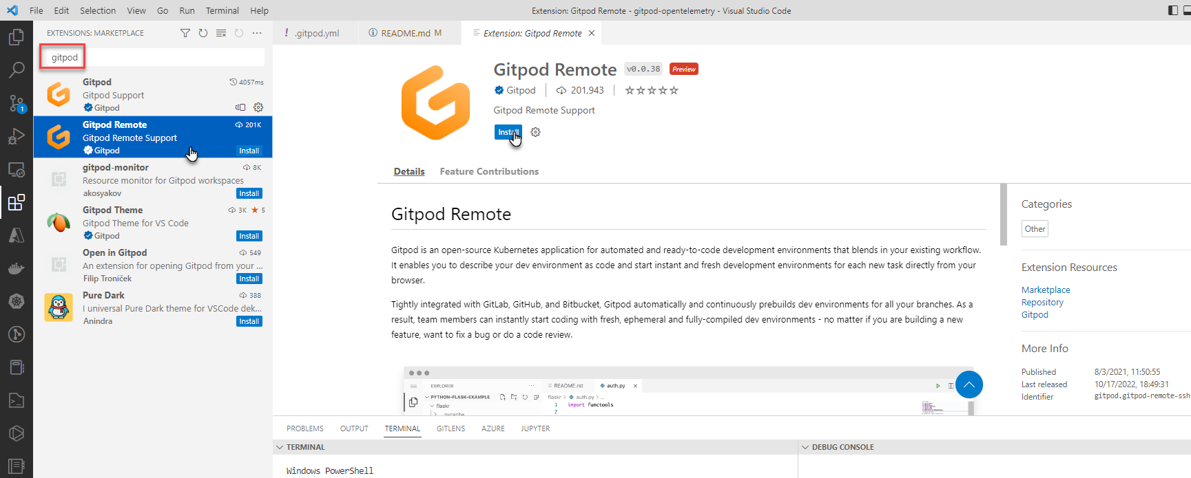
Install Gitpod Remote extension in VS Code

Slide 9
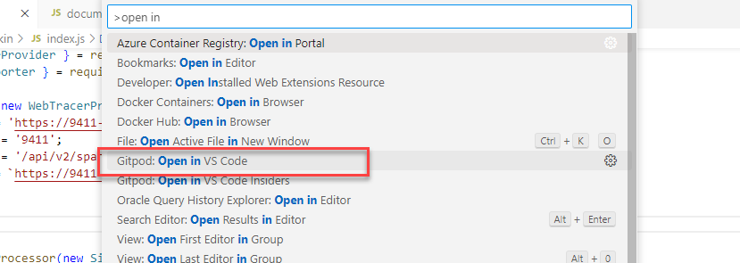
Open Workspace in VS Code Desktop (from cloud)

Slide 10
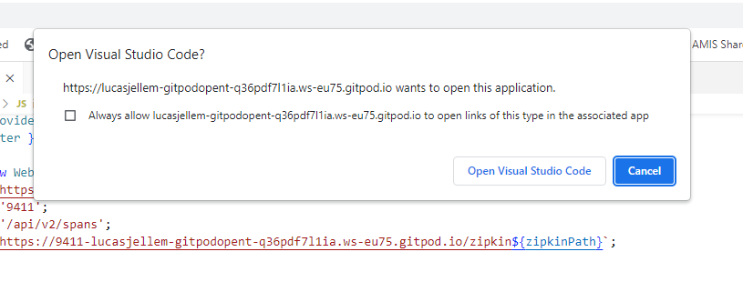
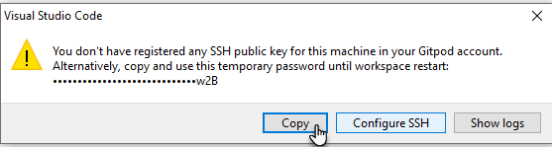
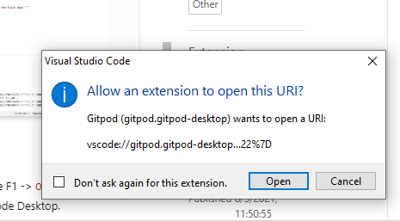
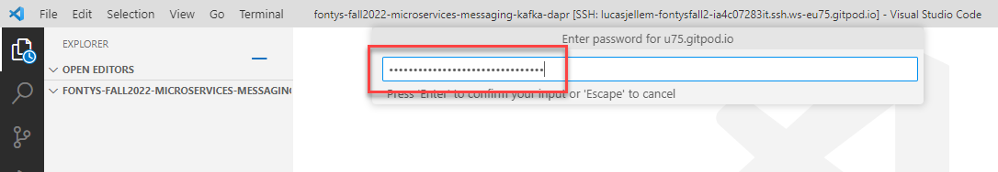
Open local VS Code and provide SSH Token

Slide 11
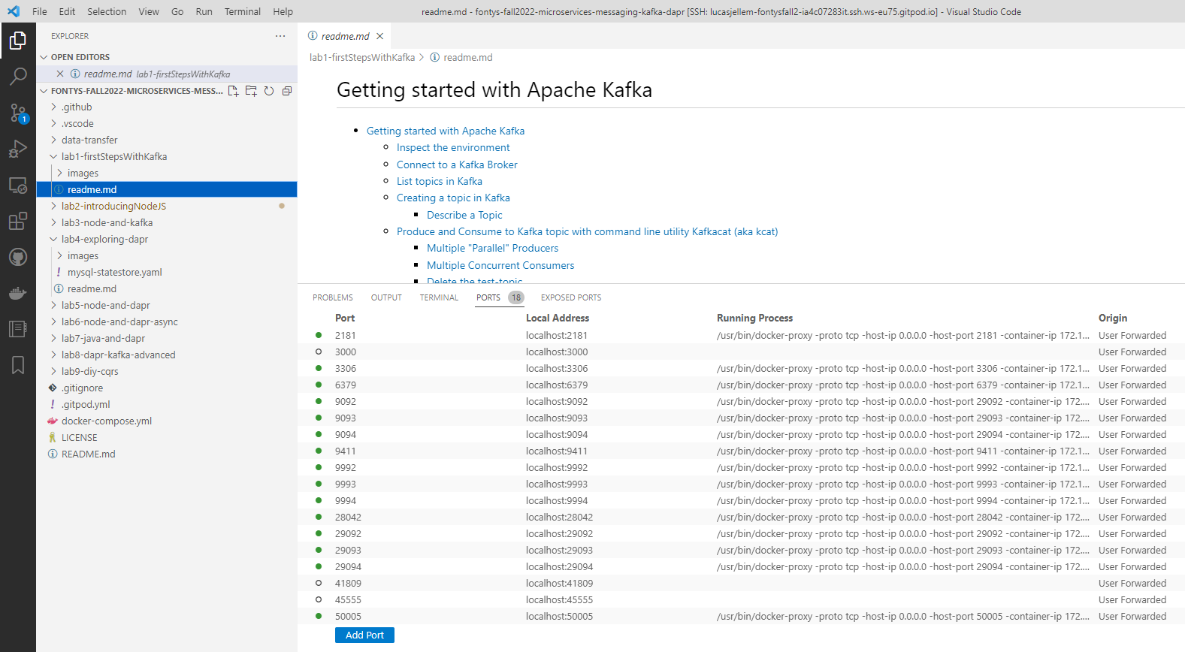
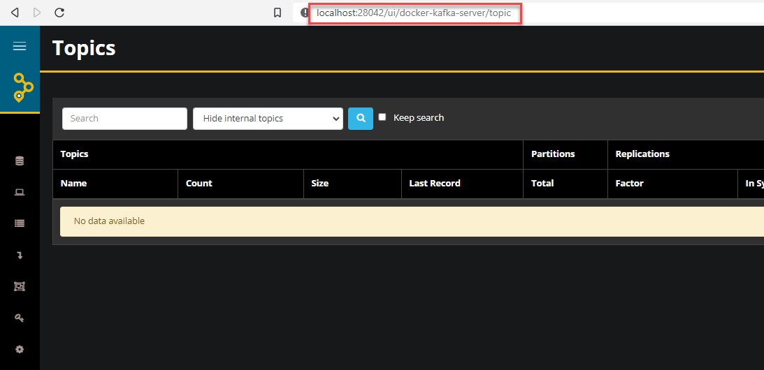
Services running in CDE can be accessed locally

Slide 12
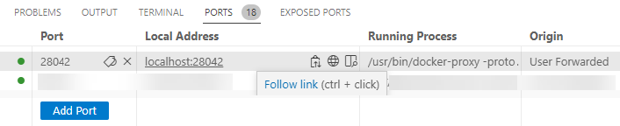
Services running in CDE can be accessed locally thanks to Port Forwarding

Slide 13
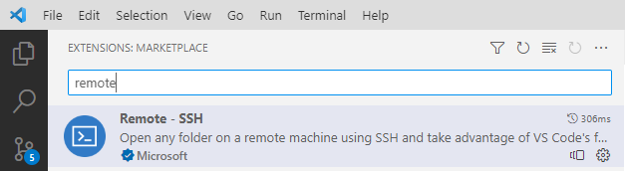
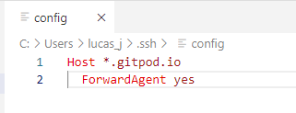
Port Forwarding with VS Code
Requires MS Remote SSH Extension
Configure .ssh/config

Slide 14



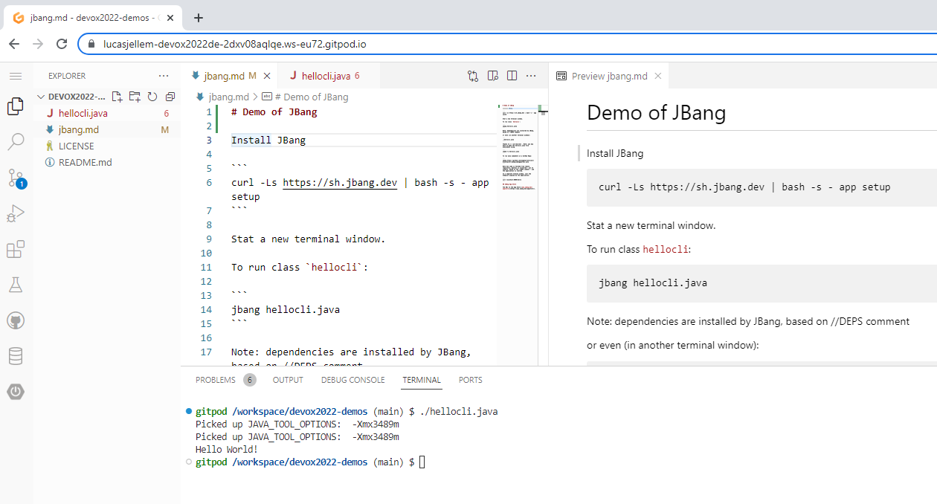
Demo – Gitpod & JBang
github.com/lucasjellema/devox2022-demos
Linux VM
Notes:
https://github.com/lucasjellema/devox2022-demos

Slide 15
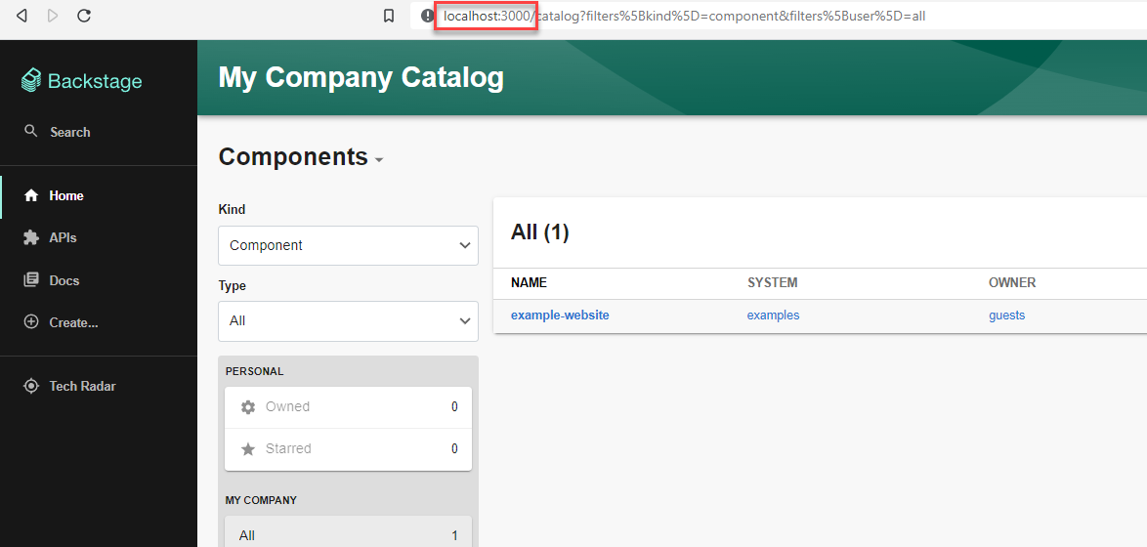

Gitpod Backstage Workspace
Linux VM

Slide 16

But wait, there is more

Slide 17
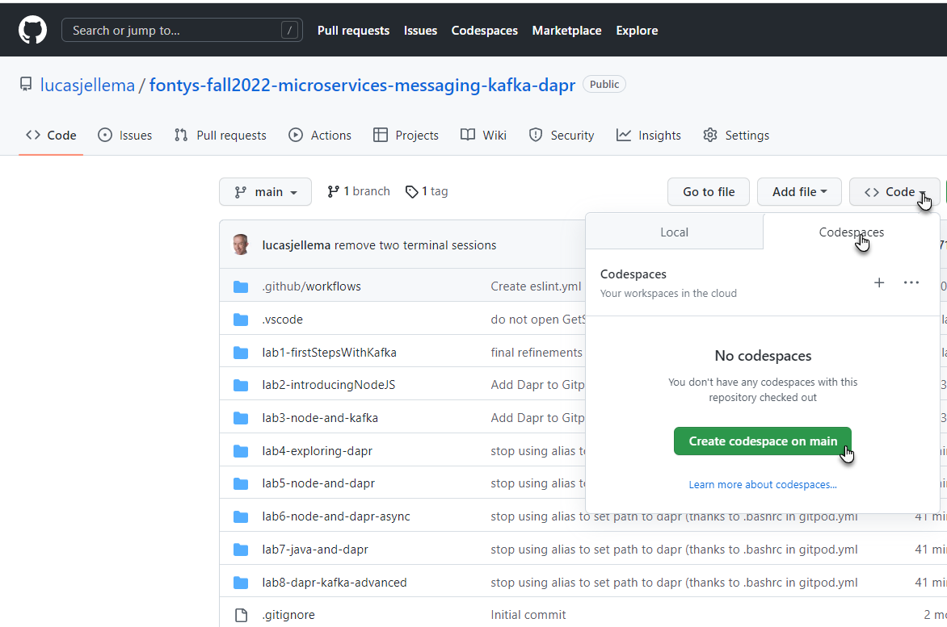
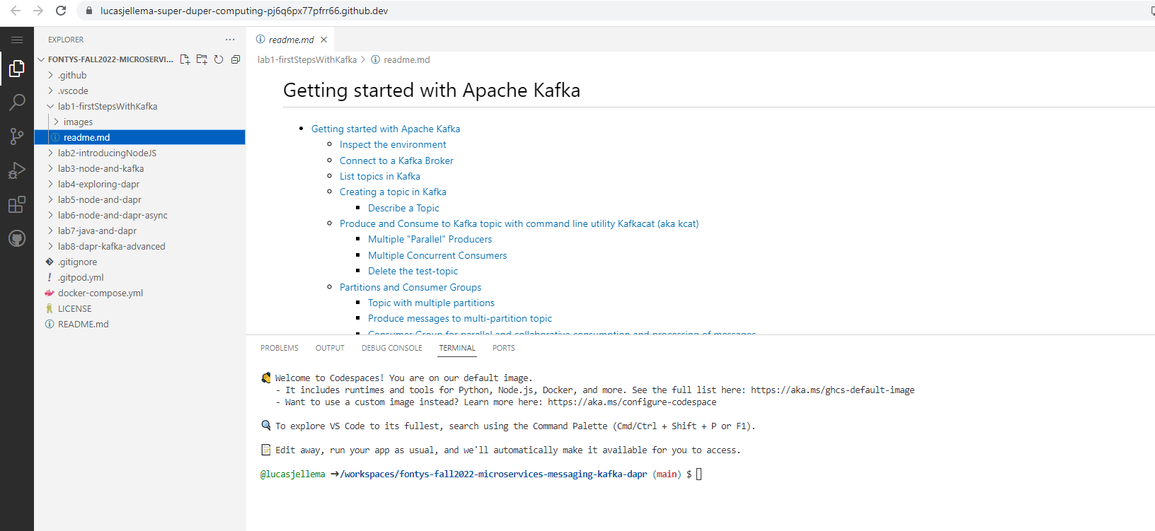

Slide 18
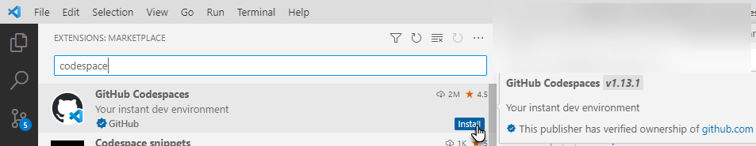
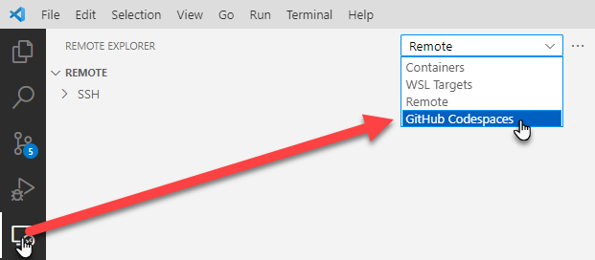
Work locally in a GitHub Codespace
Install GitHub Codespaces extension in VS Code
Remote Explorer shows GitHub Codespaces

Slide 19
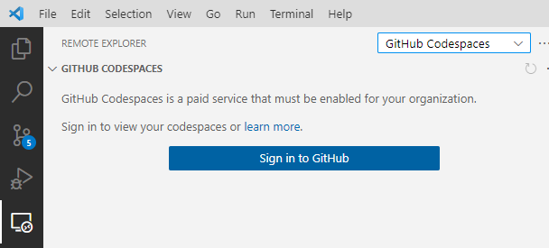
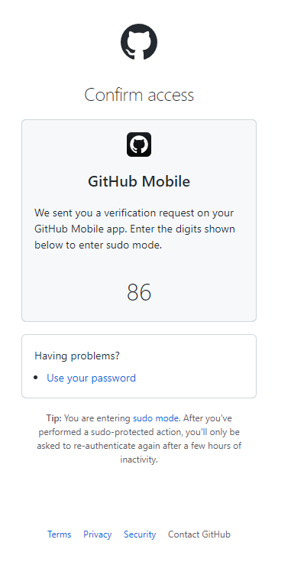
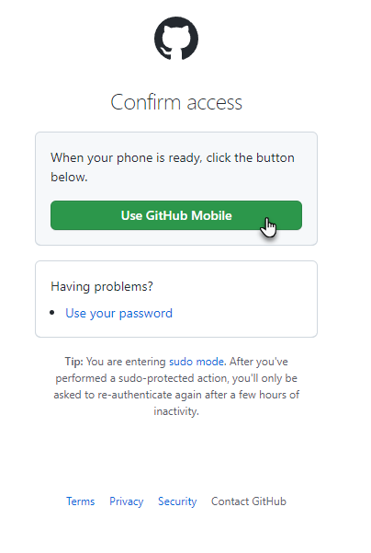
Sign in to GitHub
MFA connection to GitHub

Slide 20
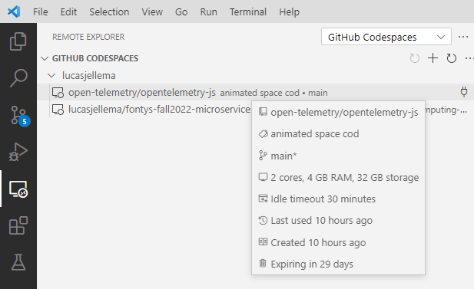
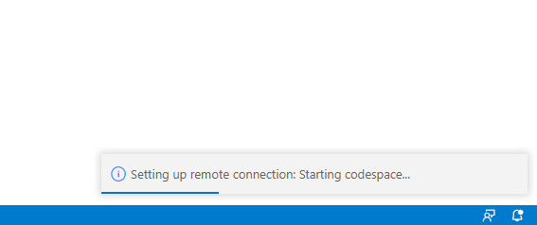
Inspect Codespaces – open codespace
Initializing Remote Connection & Starting the Codespace

Slide 21
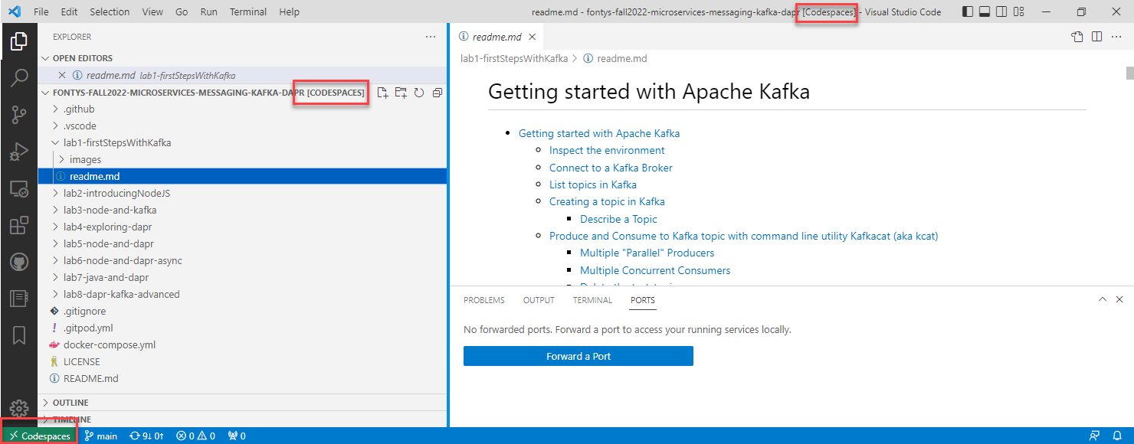
Forward ports in VS Code to SSH tunnel localhost requests to Codespace in the cloud

Slide 22
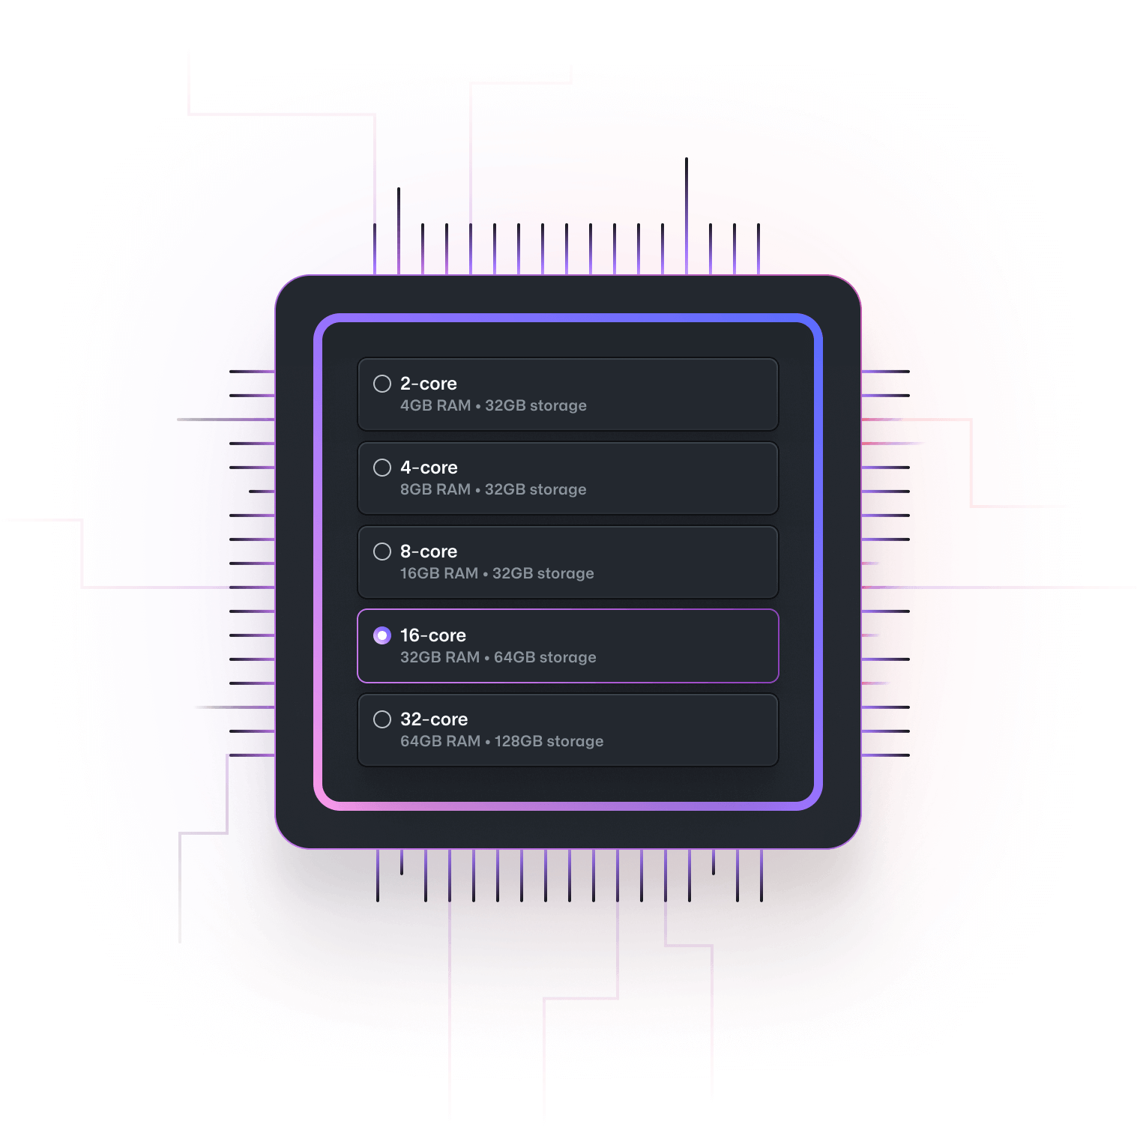
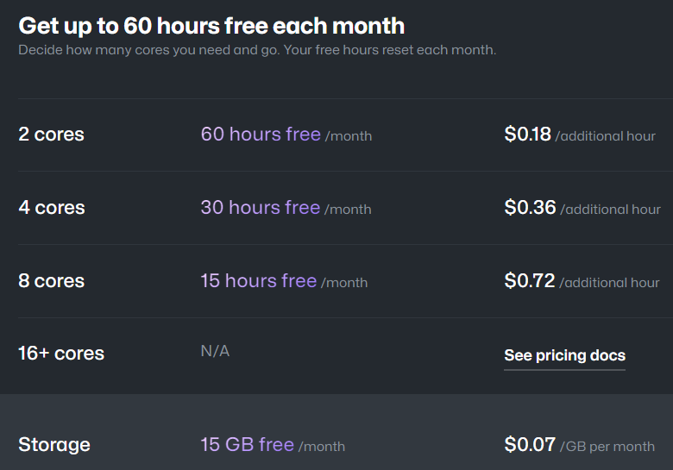
GitHub Codespaces – Options and Prices

Slide 23
Summary
..

